Slide 1
Manufacturing for STEM Engagement
VDR 1 – Team 521
Carlos Aceituno, Tristian Belardo, Leah Bergman, and Xavier Hammond
10/8/24
Notes:
Good Afternoon, We are Team 521 and Today we are presenting Manufacturing for STEM Engagement

Slide 2
Team Members
Tristian Belardo
Carlos Aceituno
Test Engineer
Leah Bergman
Computer Engineer
Tristian Belardo
Manufacturing Engineer
Xavier Hammond
Systems Engineer
Notes:
This is our team

Slide 3
Sponsors & Advisors
Tristian Belardo
Tajaey Young
Digital Services
Sales Manager
Shayla George
Software & Control Technology Consultant
Cliff Rice
Automotive,
Electric Vehicle,
and Battery Industry Consultant
James Fadool
Global OEM
Technical Consultant
Camilo Ordóñez, Ph.D.
Teaching Faculty I
Shayne McConomy, Ph.D.
Teaching Faculty II
Notes:
Here we have our sponsors and advisors for our project. Our sponsor is Rockwell Automation and their team consists of Tajaey Young, Shayla George, Cliff Rice, and James Fadool. Next we have our advisors from the FAMU-FSU College of Engineering. Our project advisor is Dr. Camilo Ordonez and our senior design professor Dr. Shayne McConomy

Slide 4
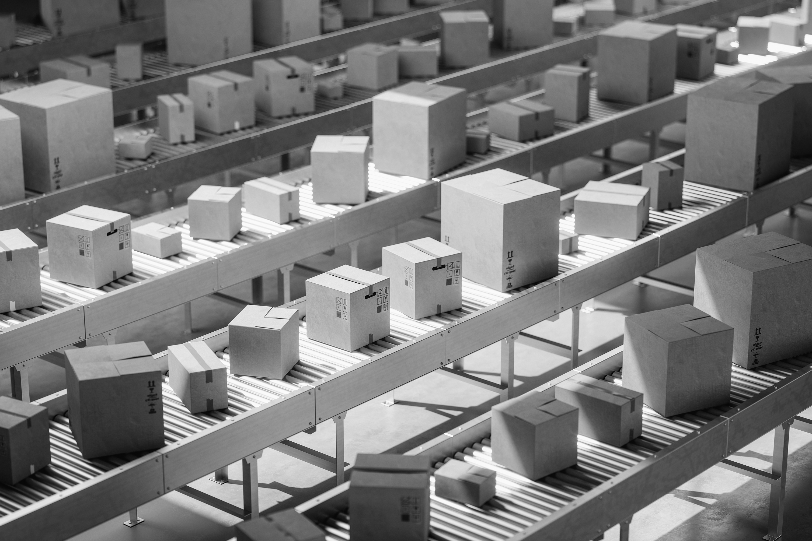
Objective
Tristian Belardo
Educate and foster engagement in manufacturing engineering through an automated demonstration.
Notes:
Our objective of this project is to create an automated manufacturing educational demo for STEM engagement that resembles a real-world engineering environment
Altered statement? The objective of this project is to educate and foster engagement in manufacturing engineering through an automated demonstration.

Slide 5
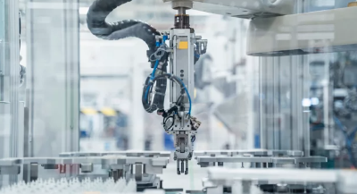
Sponsor Background
Leah Bergman
Industrial Automation
&
Digital Transformation
Emulate3D Digital Twin
Philanthropy
Notes:
Rockwell is the largest company in the world dedicated to industrial automation and digital transformation
Emulate3D: software to help design, test, and optimize automation projects
In 2021, 49% (dark blue segment) was donated towards STEM education → Manufacturing for STEM engagement!

Slide 6
Introduction to Manufacturing and Automation
Leah Bergman
Manufacturing Process
A series of steps that converts raw materials into finished goods
Mass production of a product
Can range from manual to fully automated
Notes:
Automation is an ever-growing part of manufacturing, with the continuous development of new technologies. The most common way K-12 schools teach manufacturing is with manual assembly lines. Our goal is to expand into automated demonstrations to promote STEM engagement.

Slide 7
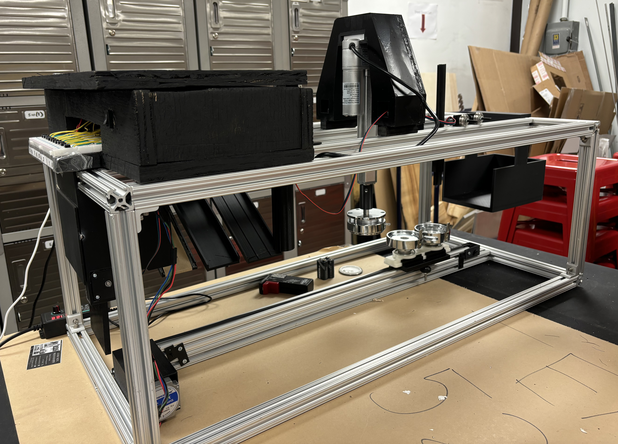
Current Design
Leah Bergman
Mylar
Button Back
Design
Button Top
Notes:
Current design: 3 motors, 3 microstep drivers, Arduino Mega, Arduino UNO
Metal frame with a conveyor belt on the bottom, gantry on top with the die mold
Linear actuator fixed above with the top of the die mold

Slide 8
Major Issues
Leah Bergman
Weak supporting frame
Malfunctioning conveyor belt
Buttons not working
Notes:
When linear actuator presses, the entire frame bends and lifts from the table
Conveyor belt doesn’t move to proper locations because the movement was hard coded without limit switches, so one power supply must be disconnected in between steps
4/9 buttons force a step in the process to start when pressed

Slide 9
Key Goals
Leah Bergman

Slide 10
Key Goals
Leah Bergman
Improve reliability of the system
Notes:
- As of brief testing we completed last week, the system successfully made three buttons in a row and failed on the fourth.

Slide 11
Key Goals
Leah Bergman
Improve reliability of the system
Teach the audience about automated manufacturing
Notes:
- As it operates now, the system requires a large amount of user interaction to successfully make a button. It lacks successful automation in the design.

Slide 12
Key Goals
Leah Bergman
Improve reliability of the system
Teach the audience about automated manufacturing
Produce a tangible item for the user to keep
Notes:
- In producing a physical item, the audience is more engaged and excited about the process.

Slide 13
Leah Bergman
Who will the achievements of these goals impact?
Notes:
- This leads into the question of “who will the achievements of these goals impact?”

Slide 14
Markets
Tristian Belardo
K-12 Institutions
Primary/Secondary Markets
After School STEM Clubs
Colleges/Universities
Notes:
This brings us to our markets. Our primary market is K -12 Institutions, as that is the target audience of this project. Our secondary markets include after-school STEM clubs and College and Universities where STEM curriculum is also present

Slide 15
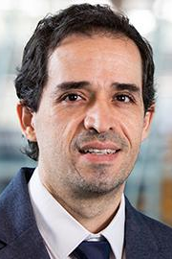
Stakeholders
Tristian Belardo
Rockwell Automation & FAMU-FSU College of Engineering
Dr. Camilo Ordóñez
Dr. Shayne McConomy
Notes:
Our stakeholders for this project include Rockwell Automation and FAMU-FSU College of Engineering. Rockwell Automation would be able to use this product to showcase what exactly their company does in manufacturing world on a small scale, and the FAMU-FSU College of Engineering could use this to promote manufacturing interests for students

Slide 16
Assumptions
Leah Bergman
System operates with some level of user input
User does not need any prior knowledge to operate the system
System is provided space and power for operation
Notes:
- To assure the completion of the product is successful, a few assumptions had to be made.
The goal is automation, not autonomy.
The product is targeted at K-12 schools, which are not filled with people familiar with manufacturing engineering.
The system will be reasonably sized but requires a flat surface and outlets to operate.

Slide 17
Customer Needs
Leah Bergman
Industrial
Uses Rockwell technology and hardware when possible
Utilizes more industrial hardened devices
Manufacture
Resembles a realistic manufacturing environment
Completes a cycle in roughly one minute
Automated
Builds upon last years design with focus on automation
Takes user input but completes a cycle on its own
Control
Includes start/stop buttons and pause input
Simple enough for use by a non-technical user
Notes:
INDUSTRIAL: Currently no Rockwell technology/hardware is in use as it operates with Arduinos right now, ideally it uses PLC’s, I/O Blocks, and Sensors
MANUFACTURE: Ensure the audience is engaged and properly educated
AUTOMATED: Focus on moving forwards instead of backwards, more reliable automation built off their design
CONTROL: We don’t want any confusion or safety hazards in the operation of the design

Slide 18
Functional Decomposition
Tristian Belardo
Rockwell Automation
Manufacturing for STEM Engagement
Manufacture
Educate
Control
Support
Notes:
This brings us to our functional decomposition of the Manufacturing for STEM engagement device

Slide 19
Functional Decomposition
Tristian Belardo
Rockwell Automation
Manufacturing for STEM Engagement
Manufacture
Educate
Control
Support
Notes:
We were able to identify 4 subsystems that align with the goals of this project. The subsystems identified are manufacture, Educate, Control, and Support

Slide 20
Functional Decomposition
Tristian Belardo
Receive Button Pin Materials
Manufacture
Assembles Button Pin
Outputs Completed Button
Notes:
The first sub-system is Manufacture, which has three functions. The first function being Receive button materials. The pin buttons are made out of three pieces which is considered our raw materials. The next function is the Assembly of the pin button. The raw materials are then pressed to together to form a completed button. This brings us to the last function where the completed button is outputted to be safely retrieved by the user

Slide 21
Functional Decomposition
Tristian Belardo
Rockwell Automation
Manufacturing for STEM Engagement
Manufacture
Educate
Control
Support

Slide 22
Functional Decomposition
Tristian Belardo
Engage User
Educate
Resembles Realistic Manufacturing Environment
Displays Manufacturing Process
Notes:
The second subsystem is Educate. Our first function is to engage the user. We want our audience to learn and remember about the manufacturing process. This brings us to our next function that we want to resemble a realistic manufacturing environment. We want to showcase what you would find in a manufacturing environment to spark interest to our audience. Our last function is to display the manufacturing process. We want to ensure that our audience can see each step in the process of making a pin button

Slide 23
Functional Decomposition
Tristian Belardo
Rockwell Automation
Manufacturing for STEM Engagement
Manufacture
Educate
Control
Support

Slide 24
Functional Decomposition
Tristian Belardo
Actuates upon User Input
Control
Receives Sensor Information
Halts in Response or Human Override
Stops upon Completion
Notes:
Our third subsystem is control. Our first function is Actuates upon user input. The user should be able to give the product input and the product does something. Our next function is to receive sensor information. Once the product starts operating we want to ensure functions are performing accurately. The next function is halts in response or human override. If something gets stuck we want the system to be able to recognize it and stop. This should also happen from user input as well. The last function is stops upon completion. The product should cycle through a completion of 1 pin button then stop.

Slide 25
Functional Decomposition
Tristian Belardo
Rockwell Automation
Manufacturing for STEM Engagement
Manufacture
Educate
Control
Support

Slide 26
Functional Decomposition
Tristian Belardo
Maintains Rigidity
Support
Aligns Materials Accurately
Assembles with Ease
Notes:
The last subsystem is support. The first function is maintains rigidity. As the product is moving and forming a button we want to ensure that its shell keeps it shape. The next function is aligns materials accurately. We want to ensure that when the button is being formed that it is in the correct position to prevent mistakes. The last function is assembles with ease. The product is expected to travel and should be able to be assembled by anyone. And this concludes our functional decomposition

Slide 27
Future Work
Tristian Belardo
Emulate3D
Component Research
PLC Learning Course
Notes:
Moving forward, we would like to start bringing our current design and ideas into Emulate 3D. Emulate3D will allow us to design, test, and optimize our project in a digital space. We would also like to do some component research. Some parts of the current design, such as the linear actuator and conveyor gantry, are missing vital sensors that prevent the completion of certain tasks. Lastly, we are in the process of completing a PLC Learning Course. Our current design uses Arduino boards, which are not found in real manufacturing, and we are potentially going to switch to PLCs.

Slide 28
References
Smart Manufacturing Industrial Automation | Rockwell Automation | US
Types of Manufacturing Processes: A Detailed Guide (deskera.com)
https://mx.pinterest.com/pin/711005859956621471/

Slide 29
Stay tuned for more!
“Working together, we'll drive better outcomes and achieve results.”
- Rockwell Automation

Slide 30
Functional Decomposition
Tristian Belardo
Function | Manufacture | Educate | Control | Support
Receive pin button materials | X
Assembles pin button | X
Outputs Completed button | X
Engage User | X | X
Displays Manufacturing Process | X | X
Resembles realistic manufacturing process | X | X

Slide 31
Functional Decomposition
Tristian Belardo
Function | Manufacture | Educate | Control | Support
Actuates upon user input | X | X | X
Receives Sensor Information |  |  | X
Operates by Given Computer Data | X |  | X
Halts in response to error or user override |  | X | X
Stops upon completion | X |  | X
Maintains rigidity |  |  |  | X

Slide 32
Functional Decomposition
Tristian Belardo
Function | Manufacture | Educate | Control | Support
Aligns Materials Accurately |  |  | X | X
Assembles with Ease |  |  |  | X

Slide 33
Back Up Slides

Slide 34
Slide Headline
Try to keep text at 16 pt minimum.
Try to put as few words as possible on the slide if you’re using for a presentation.
Mix and match the backgrounds as shown in this template or just use one throughout.
You can put department/unit logos in slide master at Horizontal 0.89” Vertical 6.44” From top left corner

Slide 35
Font Check
This is 10-point
This is 15–point Times
This is 20–point
This is 25–point
This is 30–point
This is 35–point
This is 40–point
This is 50–point
This is 60–point
This is 72–point
Notes:
Use at least 20-point font in Room A105, B134, and B136
Use at least 25-point font in Room B135

Slide 36
College of Engineering Color Palette
1 2 3 4
Pantone: PMS 195 C
RGB: 120, 47, 64
Hex: #782F40
CMYK:19, 90, 50, 55
1 2 3 4
Pantone: Black C
RGB: 0, 0, 0
Hex: #000000
CMYK:0, 0, 0, 100
Garnet
Black
1 2 3 4
RGB: 238, 118, 36
Hex: #EE7624
CMYK:2, 66, 99, 0
1 2 3 4
Pantone: PMS 000C
RGB: 255, 255, 255
Hex: #FFFFFF
CMYK: 0, 0, 0, 0
Fang
Orange
White
Notes:
Avoid 75% Black in B135

Slide 37
Accent Color Palette
1 2 3 4
RGB: 0, 59, 111
Hex: #003B6F
CMYK:
1 2 3 4
RGB: 0, 59, 111
Hex: #003B6F
CMYK:
1 2 3 4
RGB: 251, 236, 93
Hex: #FBEC5D
CMYK:
1 2 3 4
RGB: 219, 215, 210
Hex: #DBD7D2
CMYK:
1 2 3 4
RGB: 251, 236, 93
Hex: #FBEC5D
CMYK:
1 2 3 4
RGB: 219, 215, 210
Hex: #DBD7D2
CMYK:
Tardis Blue
Tardis Blue
Corn
Timberwolf
Corn
Timberwolf
1 2 3 4
RGB: 206, 0, 88
Hex: #CE0058
CMYK: 0, 100, 43, 12
1 2 3 4
RGB: 206, 0, 88
Hex: #CE0058
CMYK: 0, 100, 43, 12
1 2 3 4
RGB: 104, 40, 96
Hex: #682860
CMYK:
1 2 3 4
RGB: 220, 220, 220
Hex: #DCDCDC
CMYK:
Rubine Red
Rubine Red
Imperial
Gainsboro
1 2 3 4
RGB: 72, 146, 155
Hex: #48929b
CMYK:
1 2 3 4
RGB: 64, 224, 208
Hex: #40E0D0
CMYK:
1 2 3 4
RGB: 255, 139, 0
Hex: #FF8B00
CMYK:
Asagi-iro
Turquoise
American Orange
Notes:
Remove American orange add hyperlink grey
Make corn the last for b135
All work in 134 imperial move later
Tardis doesn’t work in b136

Slide 38
F7AB19
D67F15
EE7624
D64615
F73119
Analogous
6E3610
F0A16C
EE7624
6E4931
BASB1C
Monochromatic
A14508
4BED3B
EE7624
250CED
2010A1
Triad
A1470C
FF8C40
EE7624
0098A1
24E2ED
Complementary
28A164
2FED8D
EE7624
0848A1
1871ED
Split Complementary
EDAC2F
3BED93
EE7624
0C6AED
ED2F18
Double Split Complementary
ED660C
C7ED3B
EE7624
0CE1ED
A418ED
Square
BA7E09
87724A
EE7624
60EFCF
09BA61
Compound
https://color.adobe.com/create/color-wheel
AD551A
6E3610
EE7624
FA7625
D46820
Shades
Notes:
These are the variants that work well with Fang Orange. The bolded items show well on the projectors.

Slide 39
85412D
8F3831
782f40
8F3176
792D85
Analogous
C44D69
8E626D
782F40
C48796
451B25
Monochromatic
C43959
78743B
782F40
236178
43A2C4
Triad
C43959
C46078
782F40
25C43D
2F783A
Complementary
93C460
577835
782F40
39C49D
297861
Split Complementary
784435
5A783B
782F40
237860
6E2978
Double Split Complementary
782337
78683b
782F40
237830
293978
Square
AB4D32
DEBAAF
782F40
5D8555
70AB32
Compound
https://color.adobe.com/create/color-wheel
38161E
C44D69
782F40
853447
5E2532
Shades

Slide 40
A105
A105
B135 Stage Left
B135 Stage Right
B136
B134, A105
B135

Slide 41
Border Line
Border Line
Border Line
Center of White Space
Center of Slide
Middle of Slide
Middle of White Space
Edge of Branding
Border Line
Notes:
Vertical lines from top down.
Borderline and top of title. (0.5 inch)
Center of Slide (0 inch y-direction for the entire slide)
Center of Design Content (0 inch y-direction considering the title, footer, and negative space)
Bottom of Design Content (0.25 in gap to the footer. 0.75 to the bottom of the screen)
Horizontal lines from left to right
Borderline (0.5 inch)
Center of design content.
Center of slide (0 inch y-direction for the entire slide)
Borderline (0.125 inch all around)

